Slide 1
Week 5
Peer Assisted Learning

Slide 2


Slide 3

Benefits of PAL
Helps attendees to improve their academic confidence in a supportive environment.
Helps build a sense of community in departments.
Can particularly help WP students.
Gives PAL Leaders valuable developmental opportunities.

Slide 4

Role of a PAL Leader
Facilitate regular PAL sessions.
Take attendance lists and return to Peer Support.
Work collaboratively with other PAL Leaders to plan and run sessions.
Meet with Senior PAL Leaders to review and develop sessions at weekly debriefs.
Promote PAL and encourage attendance, including new taster sessions where possible.

Slide 5

You could be a PAL Leader next year!
Lead sessions, help others, and develop valuable skills –
Communication skills.
Public speaking and presentation skills.
Teamwork and organisation.
Scan the QR code to find out more.
thesubath.com/peer-support/pal/becomeapalleader/

Slide 6
Today
Memory Management in C - Malloc Examples
General questions on C at the end to attempt, or if you would prefer you can do your coursework ☺
Hopefully time for a kahoot at the end.

Slide 7
Memory Management in C
C has two forms of memory allocation. Static allocation and dynamic allocation.
Static allocation happens when you declare a static or global variable. These define one block of space, of a fixed size.
Dynamic allocation is used when the amount of memory you need for a variable is not known before a program runs.
When you use dynamic allocation, you allocate and free memory while the code is running.

Slide 8
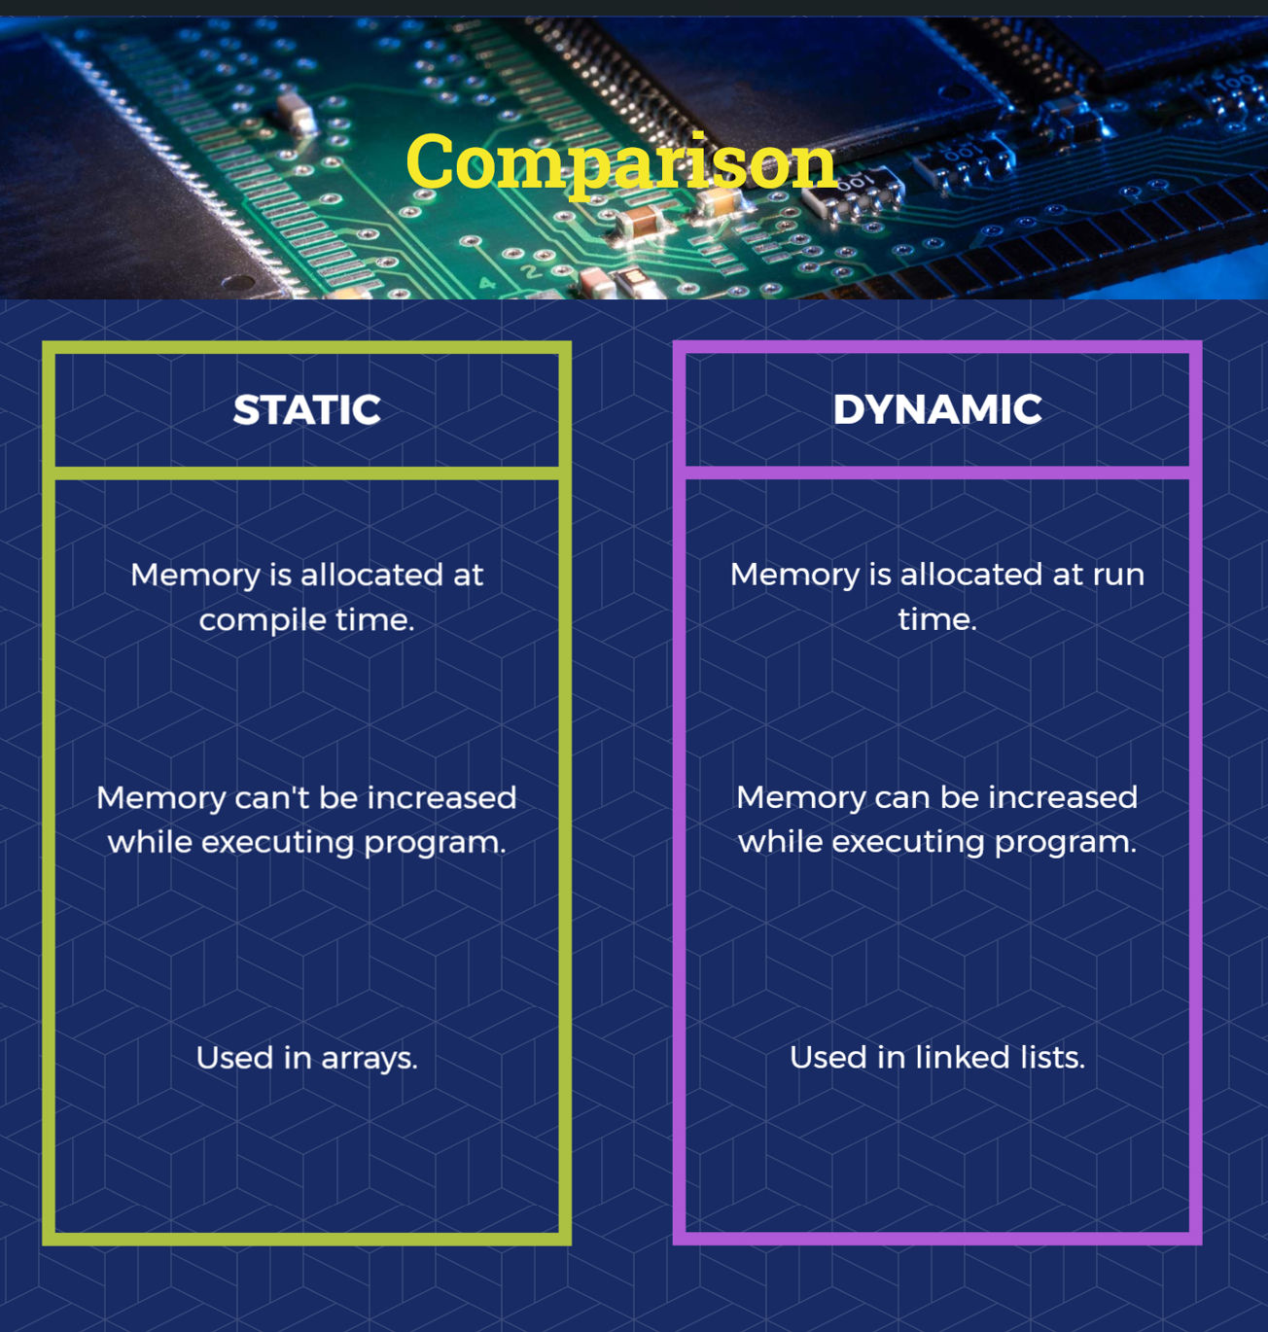
Reference:
https://www.javatpoint.com/dynamic-memory-allocation-in-c

Slide 9
Methods for Dynamic Allocation
Malloc() – Allocates single block of requested memory.
Calloc() – Allocates multiple blocks of requested memory, initialising all blocks to zero.

Slide 10

Methods for Dynamic Allocation
Realloc() – Reallocates memory occupied by a malloc()/calloc() function.
Free() – Frees the dynamically allocated memory.

Slide 11
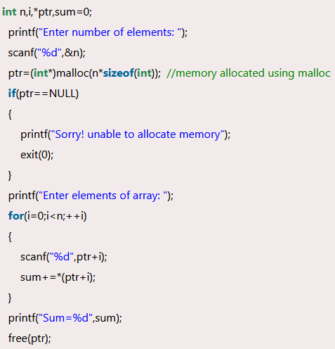
Methods for Dynamic Allocation
Allocating memory to an integer pointer (ptr), which will be able to store n integers.
The user enters elements, scanf takes in the input which is stored accordingly in the memory ptr has (ptr+i is the same as ptr[i], it goes to the next memory address in the sequence )
We then are summing these values and return it.

Slide 12

Malloc Single Example
Malloc() – Remember that malloc allocates a requested size of bytes and returns a pointer to the first byte of that allocated space.
Above we are cast typing the malloc call to a float pointer after specifying how much memory we want to reserve.

Slide 13
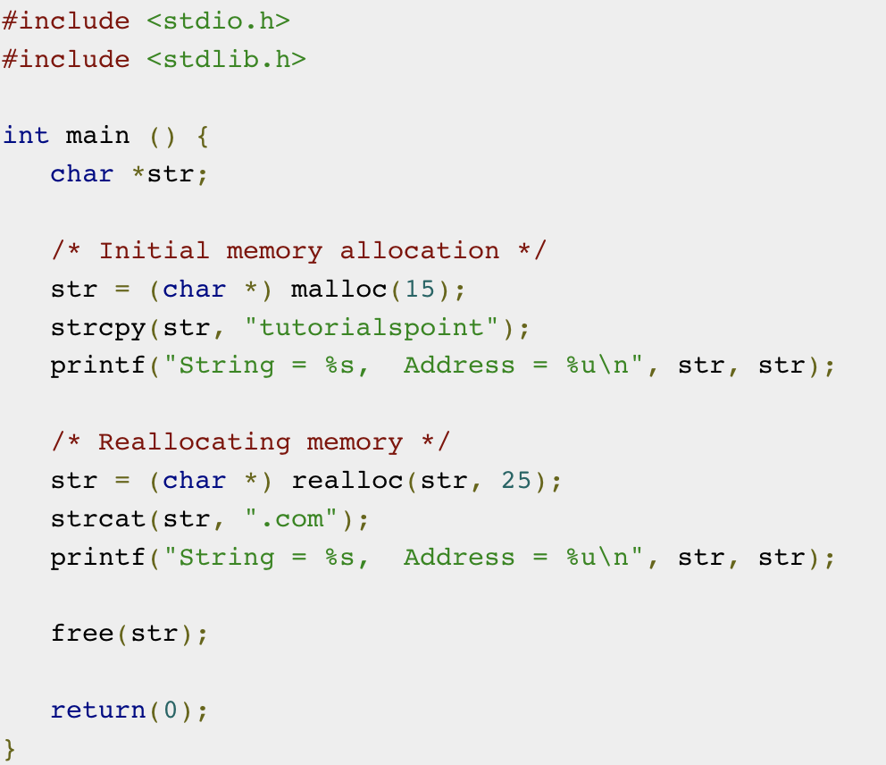
Malloc Example
First, we’re declaring a character pointer: str.
We’re allocating memory to this pointer using malloc (we’ve hardcoded in that we want space 15 characters).
We then provide the characters to be held in memory through. Strcpy.
We can realloc the memory if we want more characters
(Note that we have not checked if the character pointer here is actually NULL!!!)

Slide 14
Malloc
Allocates a number of bytes, and returns a void pointer to them
This means we should cast to our expected type
Malloc doesn’t change the values that were here in memory before (calloc() initialises to zero)
How would we allocate memory to store “Hello world!”?

Slide 15
“Hello World!”
We would say:
char *string = (char*) malloc(13 * sizeof(char));
Why do we use sizeof()?
Why do we allocate 13 characters for this string?
What happens if we do:
string = (char*) malloc(sizeof(char));

Slide 16
C Questions
What is the difference between malloc() and calloc()?
2. Following on from this, give a reason as to why would you use calloc() over malloc()?
3. How can allocate memory for an array of 15 integers on the heap (using malloc)?
4. Create a simple program that allocates memory for an integer array to store numbers [1,2,3,…., n], where n is set by the user.

Slide 17
Answers
1.
malloc() allocates a memory block of given size (in bytes) and returns a pointer to the beginning of the block. malloc() doesn’t initialize the allocated memory.
calloc() allocates the memory and also initializes every byte in the allocated memory to 0. If you try to read the value of the allocated memory without initializing it, you’ll get 0 as it has already been initialized to 0 by calloc().
Calloc takes in two arguments – the number of blocks to be allocated as well as the size of each block.

Slide 18
Answers
2. Use malloc() if you are going to set everything that you use in the allocated space. Use calloc() if you're going to leave parts of the data uninitialized - and it would be beneficial to have the unset parts zeroed.
3.

Slide 19
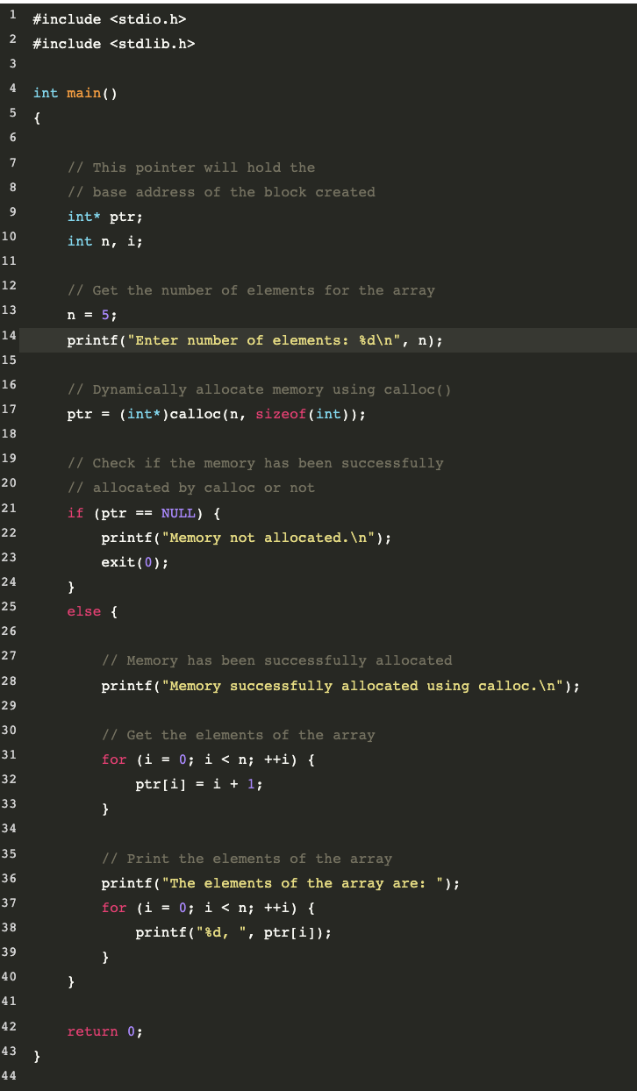
Answer 4 (Code from Geeks4Geeks)
An example of how to code can be found through this link (which is also a good resource for general understanding of memory allocation in C.
https://www.geeksforgeeks.org/dynamic-memory-allocation-in-c-using-malloc-calloc-free-and-realloc/

Slide 20
Good Resources
https://www.programiz.com/c-programming/c-dynamic-memory-allocation
https://aticleworld.com/10-interview-question-on-dynamic-memory-allocation/ (Where the last questions come from)

Slide 21
Kahoot !

Slide 22


